Slide 1
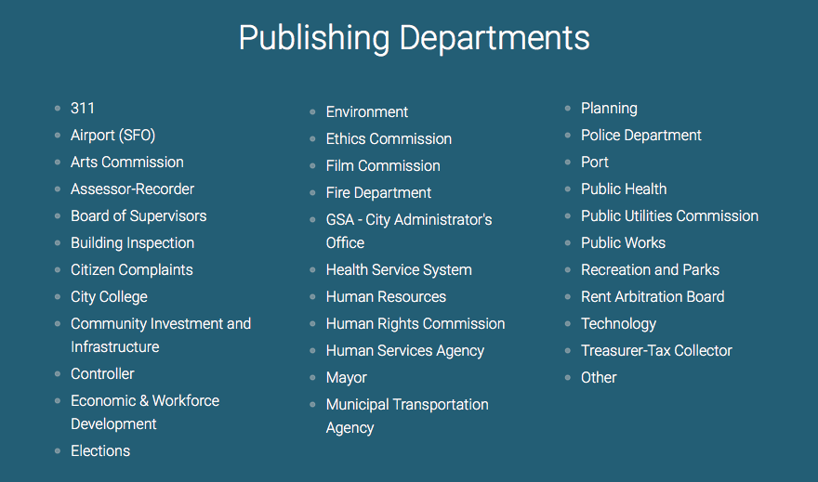
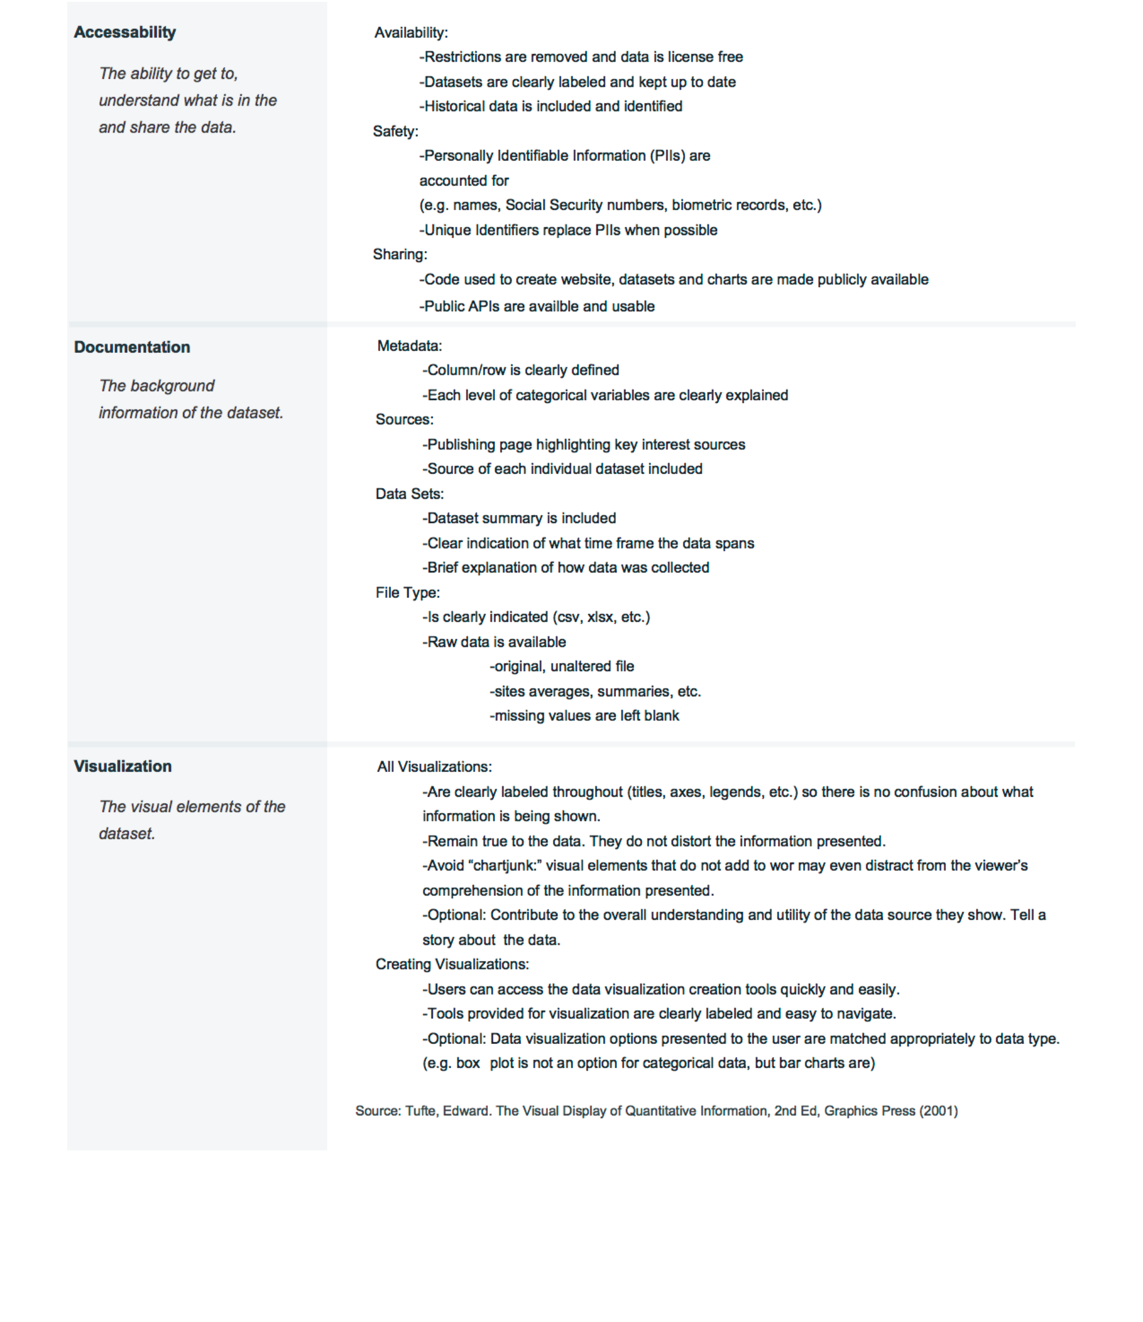
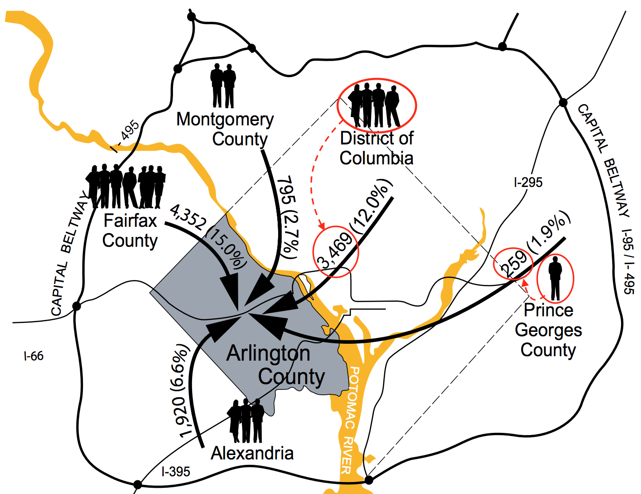
CRITERIA FOR AN EXCELLENT OPEN DATA PORTAL
Mark Almanza, Madison Arnsbarger, Jessica Flynn, Millicent Grant, Adrienne Rogers, William Sandholtz, Emily Stark, Samantha Tyner
“Open Data,” which is any publicly available information, has become increasingly popular since the 1990’s, and became especially relevant with President Obama’s emphasis on the importance of open data for “transparency, participation and collaboration” in 2016. Open data has the potential to improve government efficiency, advance local businesses, and facilitate more frequent and deeper use of government data. For these reasons, Arlington County asked students in the Data Science for the Public Good Program (DSPG) at SDAL for feedback regarding their newly-released Open Data Portal. Ultimately, the students developed a set of criteria extendable to all open data portals to aid in the evolution and improvement of general Open Data Portal standards.
Aa
Aa
Name | Sex | Date of Birth | Height (in) | Start Year | End Year
Amanda | F | 03/07/1968 | 66 | 1990 | 1996
Bradley | M | 11/05/1971 | 70 | 1994 | 1999
Connor | M | 07/17/1964 | 68 | 1988 | 1992
Danielle | F | 10/22/1970 | 67 | 1997 | 2005
Notes:
The “junk” items here are the people icons that were added to the graph. These icons represent the flow of people migrating into Arlington County from surrounding areas in 2012, but those values are also represented numerically in the same view. This reveals that, although the number of people coming from DC is more than 13 times the amount of people coming from Prince Georges County, there are only 4 person icons to represent that difference. This misleads the viewer. Better options would be to remove the people and make the numbers more prominent, or to have a legend indicating how many people each person icon represents, and have the appropriate number of icons for each region.

